Slide 1
Sensors and Manufacture
Complete guide for building and understanding the robot to recreate my algorithm

Slide 2
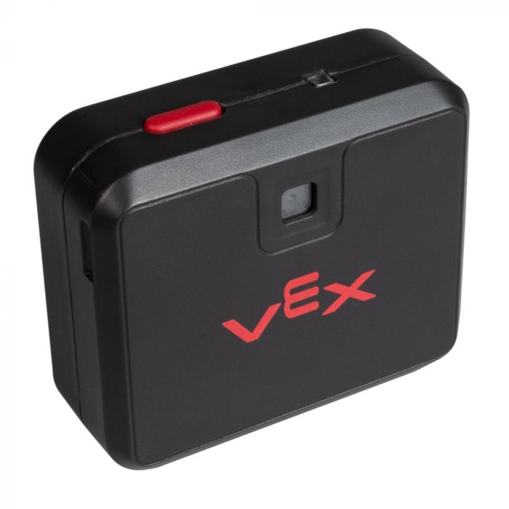
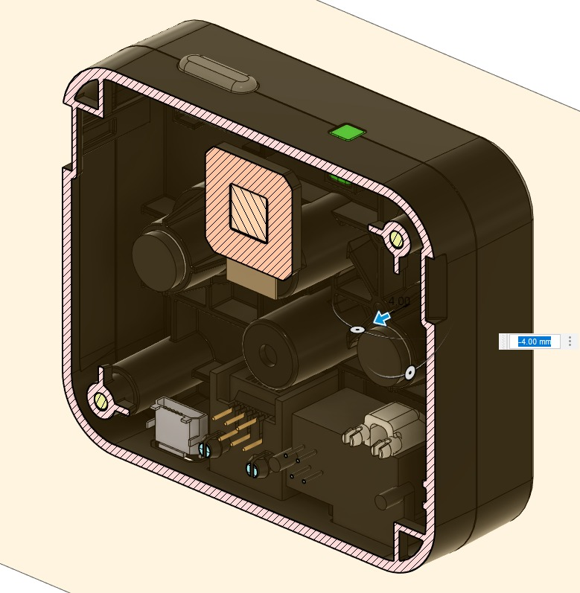
Vision Sensor
The Vision Sensor provides a robot with new capabilities and allows for expanded learning. It uses a dual ARM M4/M0 processor for object detection at 50Hz. At its most basic mode it tells you where a colored object is located. The location's X value gives you the position right and left. When the camera is tilted down, the Y value gives you the distance to the object, with a little basic trigonometry on your part.

Slide 3
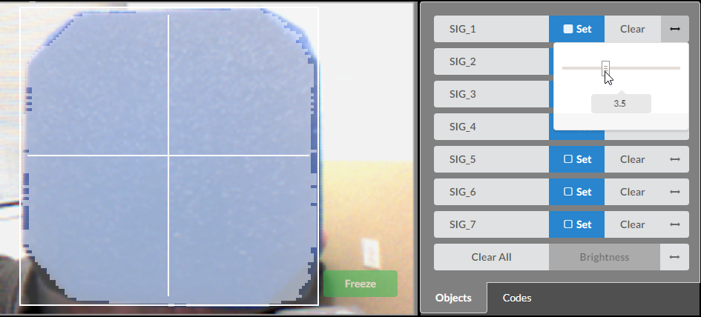
THE SENSOR PROVIDES
Allows your robot to identify objects using up to 7 different colors.
Store and track 7 unique Color Signatures
Provides position (X, Y) and size (Width, Height) of detected Color Signatures and Codes
Configured by a computer over USB

Slide 4
Vision Sensor API Can Be Accessed Via This Link
https://pros.cs.purdue.edu/v5/api/cpp/vision.html

Slide 5
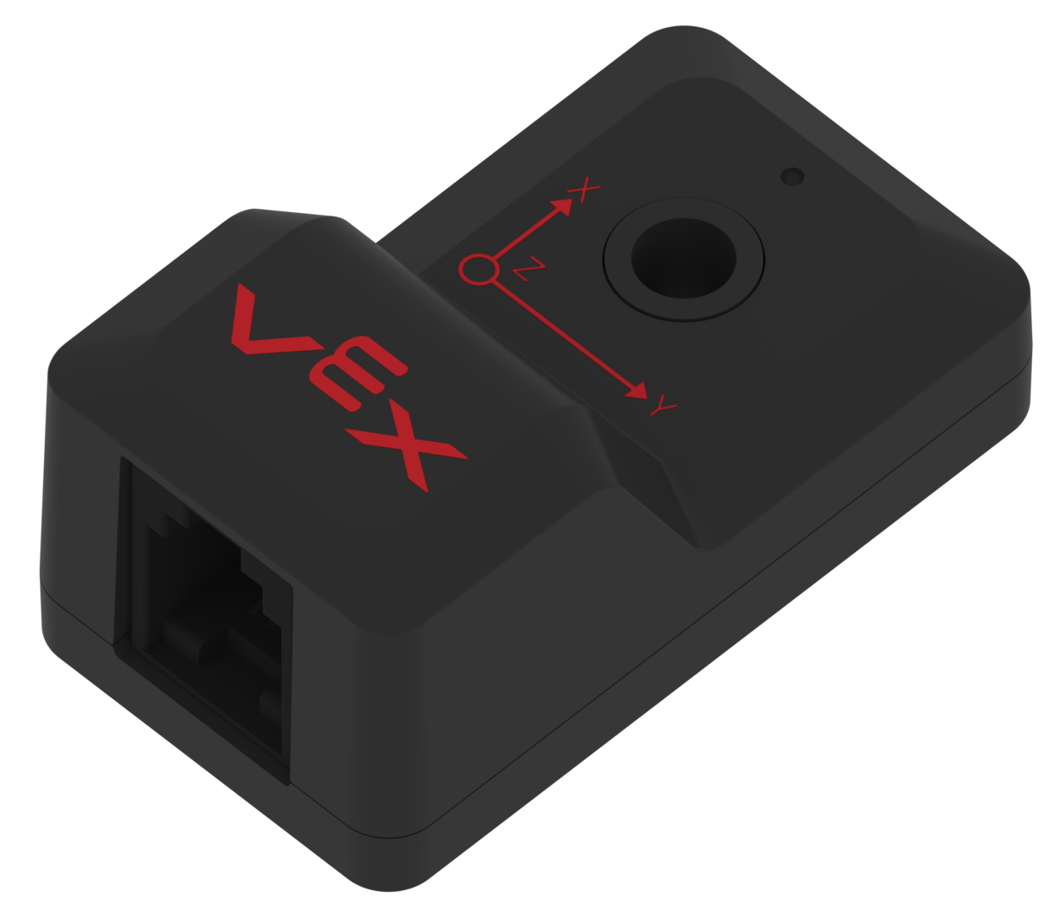
Inertial Sensor
Both the accelerometer portion and the gyroscope portion of this sensor produce a smart signal feedback to the V5 Brain.

Slide 6
How Does Inertial Sensor Work ?
Accelerometer
The accelerometer measures how fast the sensor changes its motion (accelerates) along the X-axis, the Y-axis, and/or the Z-axis. These axis are determined by the orientation of the Inertial sensor. For example, one orientation could have a robot’s X-axis as its forward and backward motion, its Y-axis as its side to side motion, and its Z-axis as its up and down motion (such as the robot lifting itself up off the field on a suspension pole).
Gyroscope
The gyroscope, rather than measuring linear motion along the 3 axis, measures the rotational motion around the 3 axis. The sensor measures this rotation when the internal electronics create a fixed reference point. As the sensor rotates away from this reference point it changes the output signal.

Slide 7
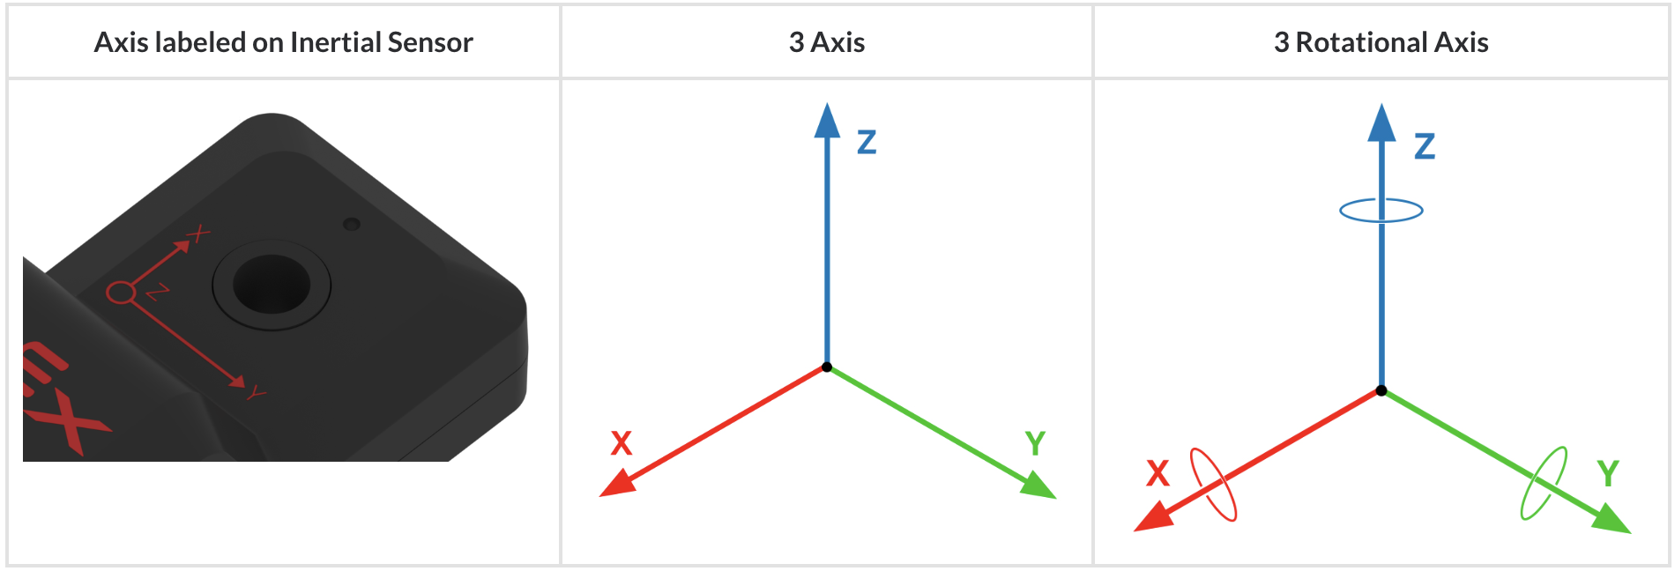

Slide 8
Inertial Sensor API Can Be Accessed Via This Link
https://pros.cs.purdue.edu/v5/api/cpp/imu.html

Slide 9
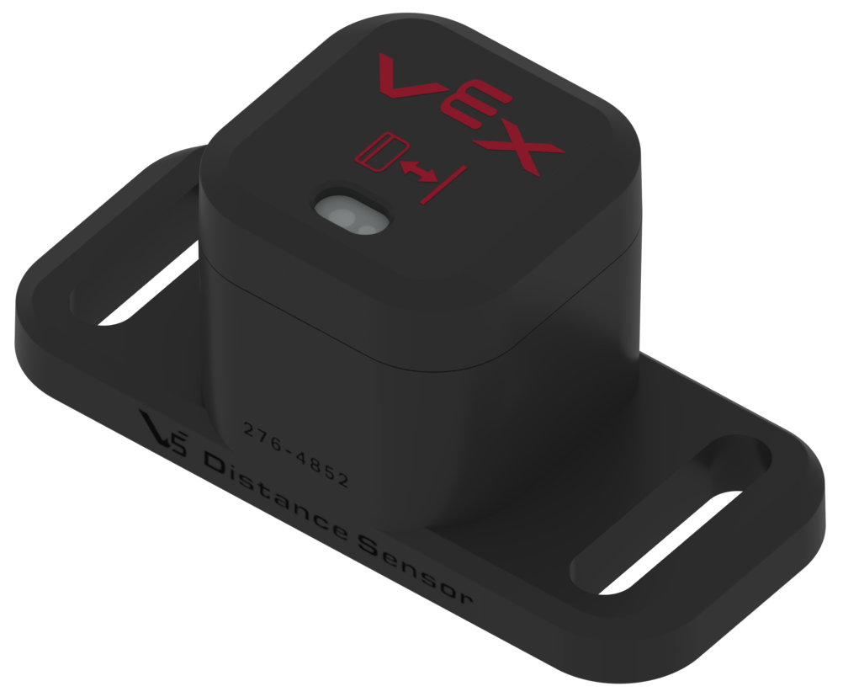
Distance Sensor
The V5 Distance Sensor can also be used to detect an object and determine the relative size of the object. The approximate size of an object is reported as small, medium, or large.The sensor can be used to calculate a robot’s approach speed. Approach speed measures the speed of the robot/sensor as it moves toward the object.

Slide 10
How Does Inertial Sensor Work ?
The V5 Distance Sensor’s measurement range is 20 millimeters (mm) to 2,000 millimeters (mm) (0.79 inch to 78.74 inches). Below 200 millimeters (mm) the accuracy is approximately +/‐15 millimeters (mm); above 200 millimeters (mm) the accuracy is approximately 5%.
The Distance Sensor needs to be paired with a programming language such as the VEXcode V5 or VEXcode Pro V5 to create a user program for the V5 Robot Brain to utilize the sensor’s readings to control the robot’s behavior.

Slide 11
Distance Sensor API Can Be Accessed Via This Link
https://pros.cs.purdue.edu/v5/api/cpp/distance.html

Slide 12
Downloading VEXcode Pro for trying out the algorithm
Via this website you can download the program and start coding using C++ libraries with the extension of specialized vex libraries.
With these libraries, I was able to spin the robot’s motors and utilize the sensors.
https://www.vexrobotics.com/vexcode/install/v5
Go to the link and click under
“Download VEXcode Pro V5 - v2.0.5”

Slide 13
Future Plan
PID Controller: continuously calculates an error value as the difference between a desired setpoint (SP) and a measured process variable (PV) and applies a correction based on proportional, integral, and derivative terms (denoted P, I, and D respectively), hence the name.
In practical terms, PID automatically applies an accurate and responsive correction to a control function.
Integrating a PID control algorithm into driving straight or turning movements

Slide 14
Building the Robot

Slide 15
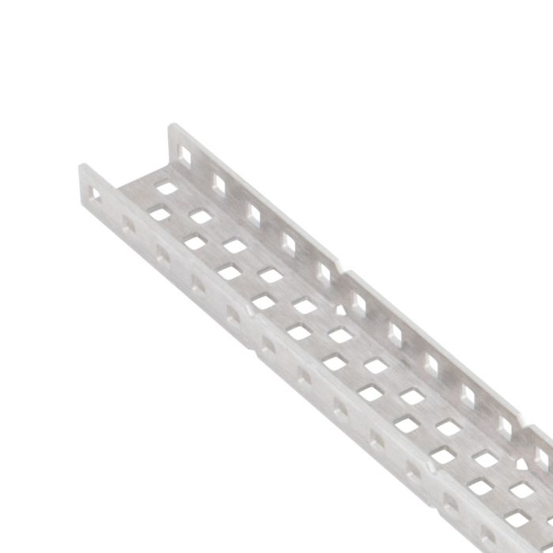
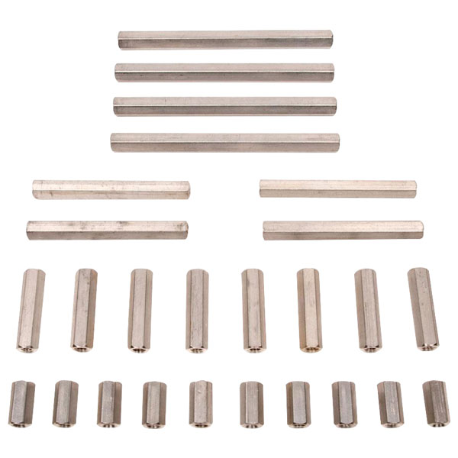
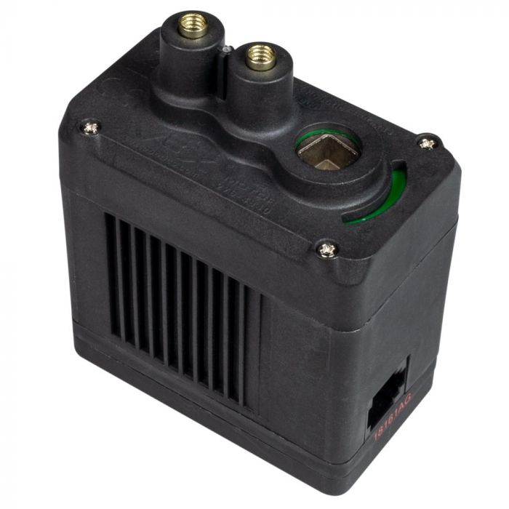
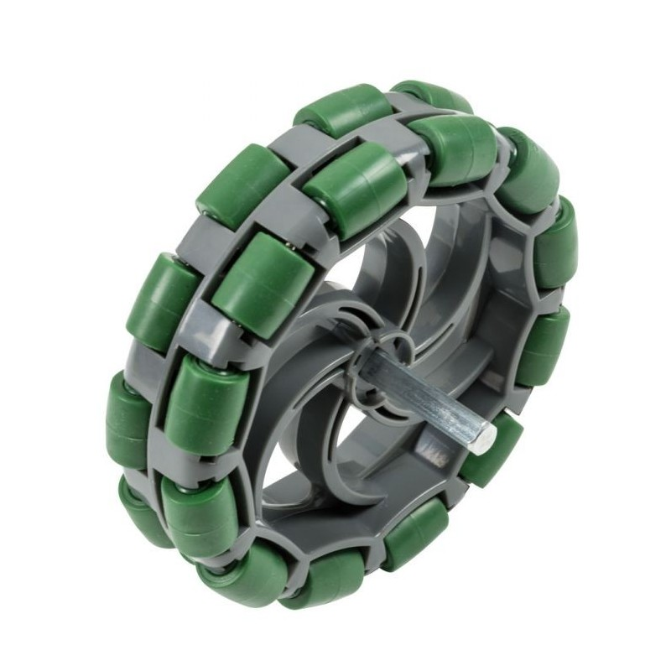
The Robot Consists of:
6 x C-channels
10 x Standoffs
6 x omni wheels
4 x V5 Smart Motors

Slide 16
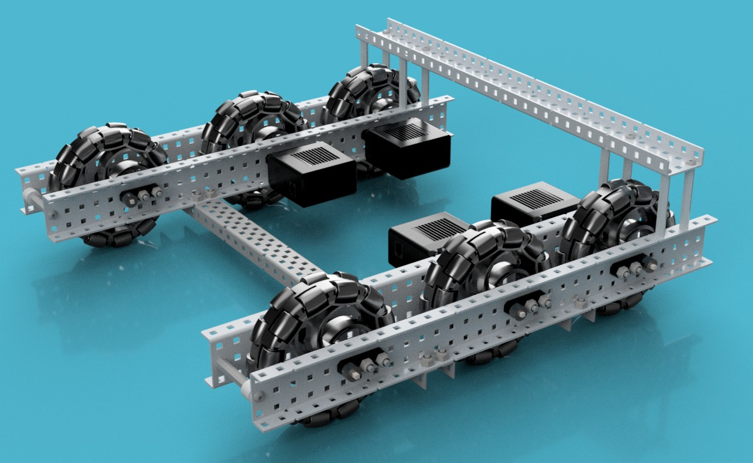
You Can Refer to the Cad files to see a complete design of the robot

